Slide 1
Performance Metrics in Machine Learning
Iftekhar Mahmud Towhid

Slide 2
Performance metrics
Performance metrics are a part of every machine learning pipeline. They tell you if you’re making progress, and put a number on it. All machine learning models, whether it’s linear regression, or a SOTA (State Of The Art) technique like BERT, need a metric to judge performance.
Every machine learning task can be broken down to either Regression or Classification, just like the performance metrics. There are dozens of metrics for both problems, but we’re gonna discuss popular ones along with what information they provide about model performance.
If you ever participated in a Kaggle competition, you probably noticed the evaluation section. More often than not, there’s a metric on which they judge your performance.

Slide 3
Performance metrics vs. Loss functions
Metrics are different from loss functions. Loss functions show a measure of model performance. They’re used to train a machine learning model (using some kind of optimization like Gradient Descent), and they’re usually differentiable in the model’s parameters.
[We will learn more about loss functions and differentiability later]
Metrics are used to monitor and measure the performance of a model (during training and testing), and don’t need to be differentiable.
However, if, for some tasks, the performance metric is differentiable, it can also be used as a loss function (perhaps with some regularizations added to it), such as MSE.

Slide 4
Regression metrics
Regression models have continuous output. So, we need a metric based on calculating some sort of distance between predicted and ground truth.
In order to evaluate Regression models, we’ll discuss these metrics in detail:
  Mean Absolute Error (MAE),
  Mean Squared Error (MSE),
  Root Mean Squared Error (RMSE),
  R² (R-Squared).

Slide 5
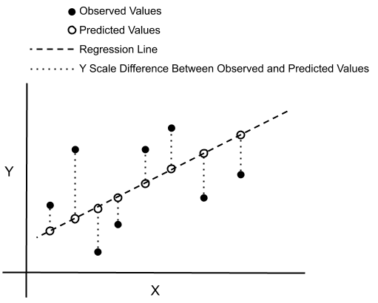
Regression error

Slide 6

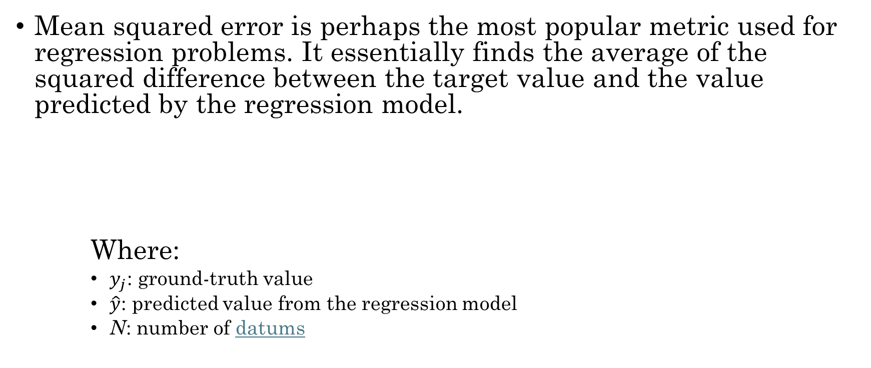
Mean Squared Error (MSE)
Mean squared error is perhaps the most popular metric used for regression problems. It essentially finds the average of the squared difference between the target value and the value predicted by the regression model.
Where:
    $y_{j}$: ground-truth value
    $\hat{y}$: predicted value from the regression model
    N: number of datums

Slide 7
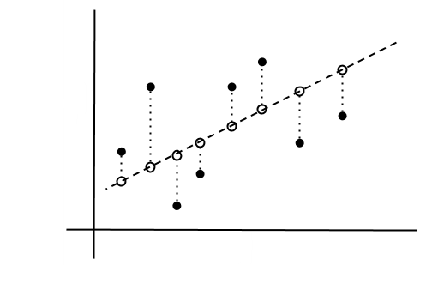

Mean Squared Error (MSE)
Few key points related to MSE:
  It’s differentiable, so it can be optimized better.
  It penalizes even small errors by squaring them, which essentially leads to an overestimation of how bad the model is.
  Error interpretation has to be done with squaring factor(scale) in mind. For example, in our Boston Housing regression problem, we got MSE=21.89 which primarily corresponds to (Prices)².
  Due to the squaring factor, it’s fundamentally more prone to outliers than other metrics.
$${(y − \hat{y})}^{2}$$
House price ($)
House size (sqft)

Slide 8

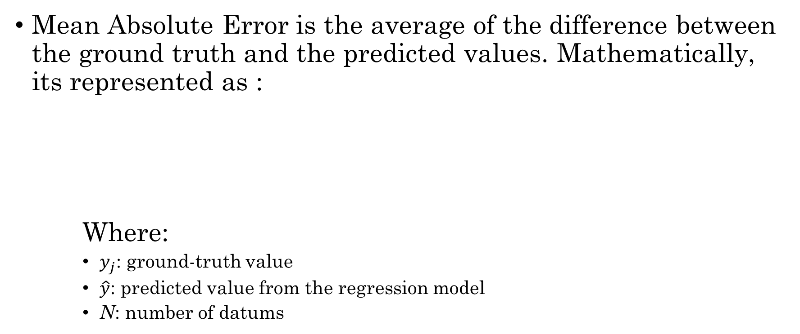
Mean Absolute Error (MAE)
Mean Absolute Error is the average of the difference between the ground truth and the predicted values. Mathematically, its represented as :
Where:
    $y_{j}$: ground-truth value
    $\hat{y}$: predicted value from the regression model
    N: number of datums

Slide 9

Mean Absolute Error (MAE)
Few key points for MAE:
  It’s more robust towards outliers than MAE, since it doesn’t exaggerate errors.
  It gives us a measure of how far the predictions were from the actual output. However, since MAE uses absolute value of the residual, it doesn’t give us an idea of the direction of the error, i.e. whether we’re under-predicting or over-predicting the data.
  Error interpretation needs no second thoughts, as it perfectly aligns with the original degree of the variable.
  MAE is non-differentiable as opposed to MSE, which is differentiable.
$$\left|y − \hat{y}\right|$$
House price ($)
House size (sqft)

Slide 10
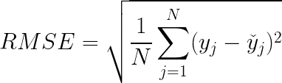
Root Mean Squared Error (RMSE)
Root Mean Squared Error corresponds to the square root of the average of the squared difference between the target value and the value predicted by the regression model. Basically, sqrt(MSE). Mathematically it can be represented as:

Slide 11
Root Mean Squared Error (RMSE)
It addresses a few downsides in MSE.
Few key points related to RMSE:
  It retains the differentiable property of MSE.
  It handles the penalization of smaller errors done by MSE by square rooting it.
  Error interpretation can be done smoothly, since the scale is now the same as the random variable.
  Since scale factors are essentially normalized, it’s less prone to struggle in the case of outliers.

Slide 12
Classification Metrics
Classification problems are one of the world’s most widely researched areas. Use cases are present in almost all production and industrial environments. Speech recognition, face recognition, text classification – the list is endless.
Classification models have discrete output, so we need a metric that compares discrete classes in some form. Classification Metrics evaluate a model’s performance and tell you how good or bad the classification is, but each of them evaluates it in a different way.

Slide 13
Metrics to Evaluate Machine Learning Classification Algorithms
These are the most used metrics for evaluating classification algorithms:
  Accuracy,
  Precision,
  Recall,
  F1 score, and
  Area under the ROC (Receiver Operating Characteristic) curve and AUC (Area Under the Curve).

Slide 14
Context for understanding metrics
Imagine you are a healthcare startup and want an Al assistant able to predict whether a given patient has a heart disease or not based on its health record. This is a binary classification problem where the model will predict
  1, True or Yes if the patient has heart disease
  0, False or No otherwise

Slide 15
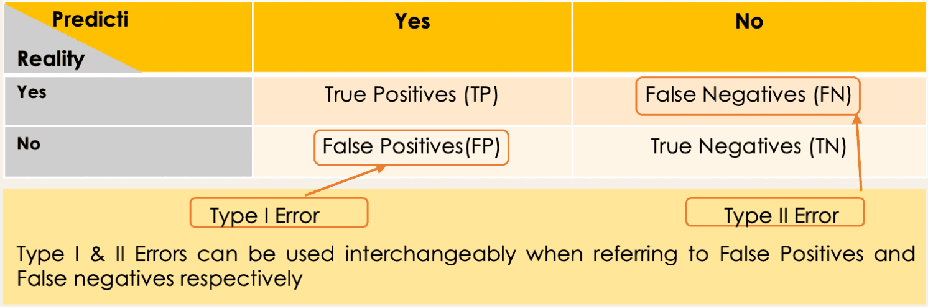
Confusion Matrix
A 2X2 matrix that nicely summarizes the number of correct predictions of the model. It also helps in computing different other performance metrics.

Slide 16
Confusion Matrix
Each cell in the confusion matrix represents an evaluation factor. Let’s understand these factors one by one:
  True Positive(TP) signifies how many positive class samples your model predicted correctly.
  True Negative(TN) signifies how many negative class samples your model predicted correctly.
  False Positive(FP) signifies how many negative class samples your model predicted incorrectly. This factor represents Type-I error in statistical nomenclature. This error positioning in the confusion matrix depends on the choice of the null hypothesis.
  False Negative(FN) signifies how many positive class samples your model predicted incorrectly. This factor represents Type-II error in statistical nomenclature. This error positioning in the confusion matrix also depends on the choice of the null hypothesis.

Slide 17
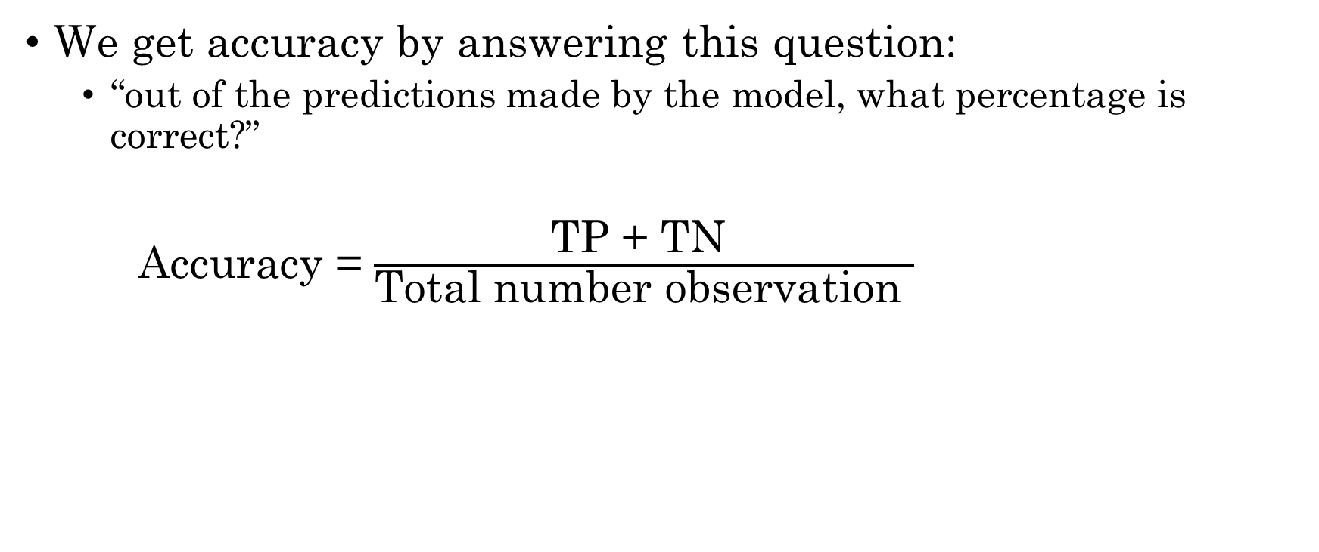
Accuracy
We get accuracy by answering this question:
  “out of the predictions made by the model, what percentage is correct?”
Accuracy = $\frac{\text{TP}\text{ + }\text{TN} }{\text{Total} \text{number} \text{observation} }$

Slide 18
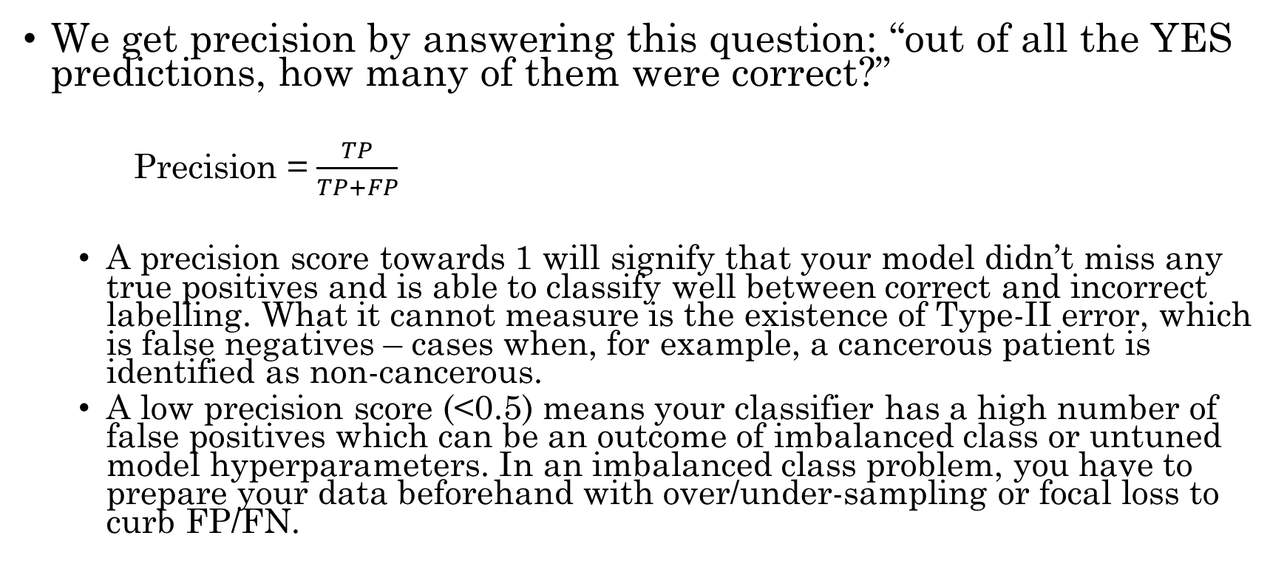
Precision
We get precision by answering this question: “out of all the YES predictions, how many of them were correct?”
  Precision = $\frac{TP}{TP+FP}$
  A precision score towards 1 will signify that your model didn’t miss any true positives and is able to classify well between correct and incorrect labelling. What it cannot measure is the existence of Type-II error, which is false negatives – cases when, for example, a cancerous patient is identified as non-cancerous.
  A low precision score (<0.5) means your classifier has a high number of false positives which can be an outcome of imbalanced class or untuned model hyperparameters. In an imbalanced class problem, you have to prepare your data beforehand with over/under-sampling or focal loss to curb FP/FN.

Slide 19
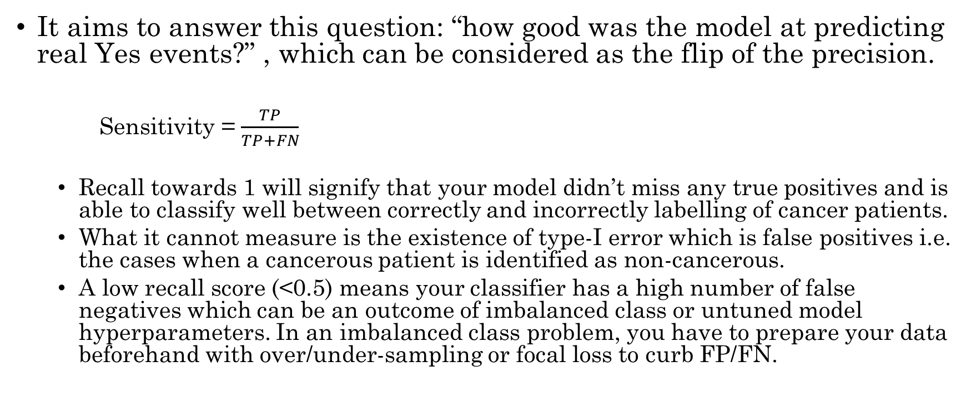
Recall / Sensitivity
It aims to answer this question: “how good was the model at predicting real Yes events?” , which can be considered as the flip of the precision.
  Sensitivity = $\frac{TP}{TP+FN}$
  Recall towards 1 will signify that your model didn’t miss any true positives and is able to classify well between correctly and incorrectly labelling of cancer patients.
  What it cannot measure is the existence of type-I error which is false positives i.e. the cases when a cancerous patient is identified as non-cancerous.
  A low recall score (<0.5) means your classifier has a high number of false negatives which can be an outcome of imbalanced class or untuned model hyperparameters. In an imbalanced class problem, you have to prepare your data beforehand with over/under-sampling or focal loss to curb FP/FN.

Slide 20

Recall / Specificity
It aims to answer this question: “how good was the model at predicting real No events”?
    Specificity = $\frac{TN}{TN+FP}$

Slide 21
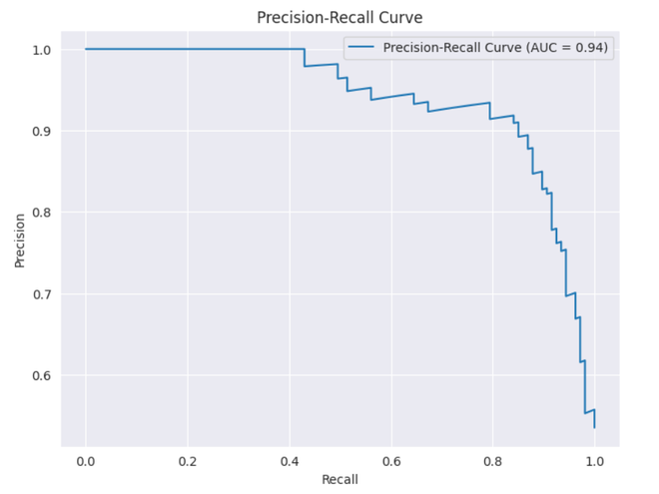
Precision-Recall tradeoff
To improve your model, you can either improve precision or recall – but not both! If you try to reduce cases of cancerous patients being labelled as non-cancerous (FN/type-II), no direct effect will take place on non-cancerous patients being labelled as cancerous (FP/type-I).
This trade-off highly impacts real-world scenarios, so we can deduce that precision and recall alone aren’t very good metrics to rely on and work with. That’s the reason you see many corporate reports and online competitions urge the submission metric to be a combination of precision and recall.

Slide 22
Fl Score
Sometimes used when dealing with imbalanced data set, meaning that there are more of one class/label than there are of the other. It corresponds to the harmonic mean of the precision and recall.
    F1 Score = 2 × $\frac{Precision × Recall}{Precision+Recall}$

Slide 23
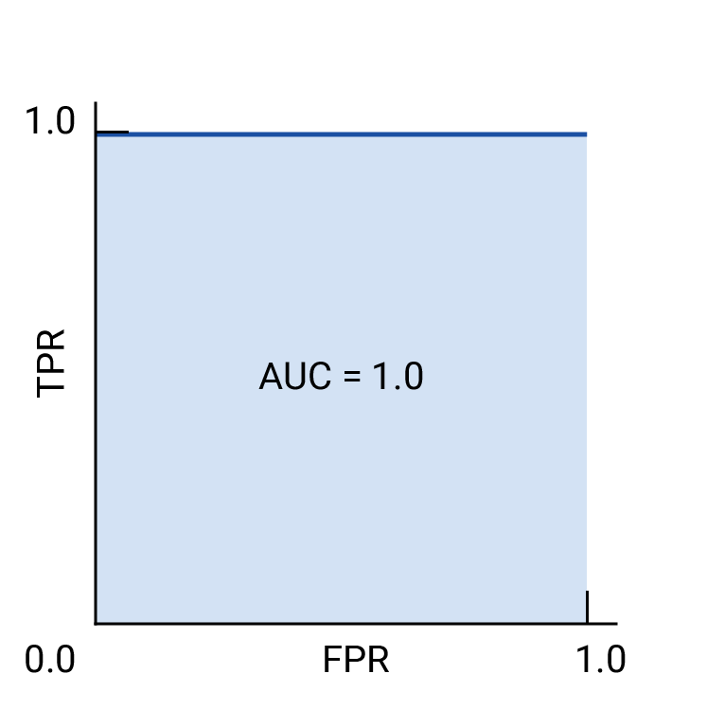

Receiver-operating characteristic curve (ROC)
The ROC curve is a visual representation of model performance across all thresholds.
The ROC curve is drawn by calculating the true positive rate (TPR) and false positive rate (FPR) at every possible threshold (in practice, at selected intervals), then graphing TPR over FPR. A perfect model, which at some threshold has a TPR of 1.0 and a FPR of 0.0, can be represented by either a point at (0, 1) if all other thresholds are ignored, or by the following (right image):
ROC and AUC of a hypothetical perfect model.
$$TPR= \frac{TP}{TP+FN} FPR= \frac{FP}{FP+TN}$$

Slide 24
AUC - ROC Curve
The area under the ROC curve (AUC) represents the probability that the model, if given a randomly chosen positive and negative example, will rank the positive higher than the negative.
AUC— ROC generates probability values instead of binary 0/1 values. It should be used when your data set is roughly balanced.
Using ROC for imbalanced data sets lead to incorrect interpretation.
ROC curves provide good overview of trade-off between the TP rate and FP rate for binary classifier using different probability thresholds.
  A value below 0.5 indicates a poor classifier
  A value of 0.5 means random classifier
  Value over 0.7 corresponds to a good classifier
  0.8 indicates a strong classifier
  We have 1 when the classifier perfectly predicts everything.

Slide 25
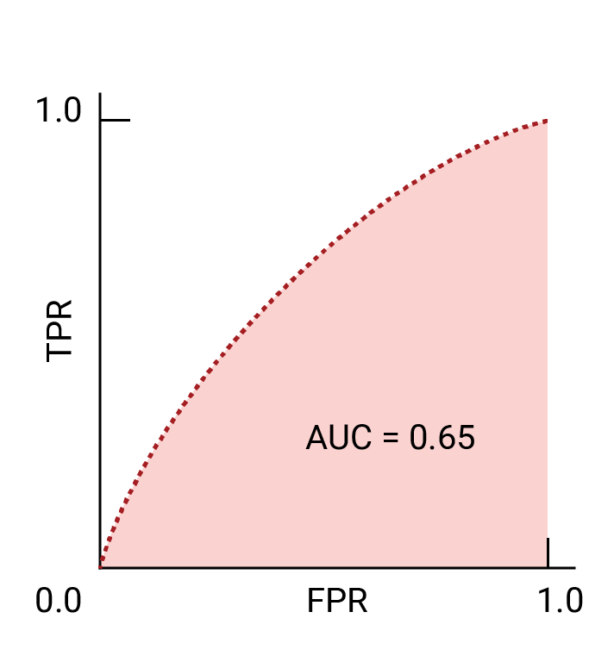
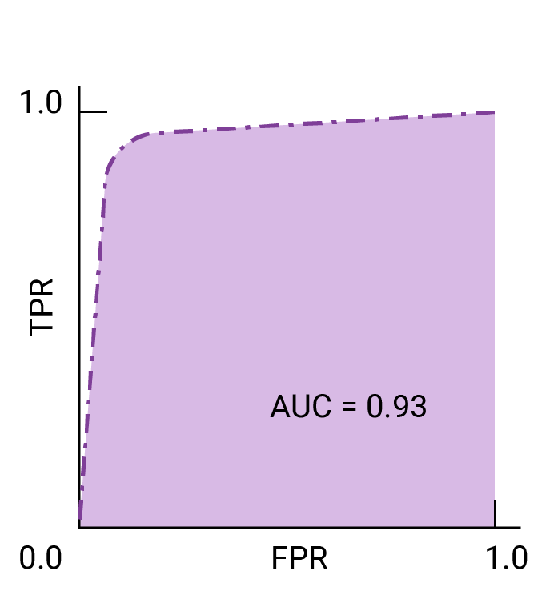
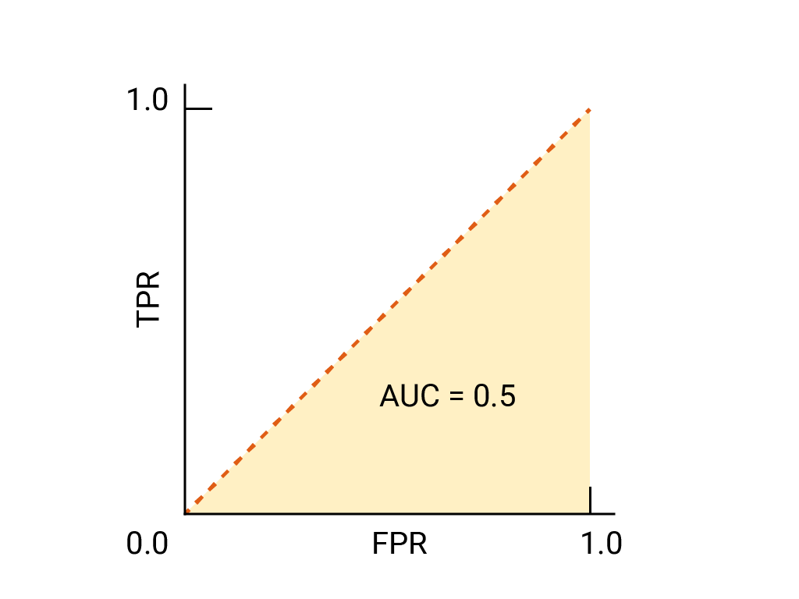
AUC - ROC Curve
ROC and AUC of completely random guesses.
ROC and AUC of two hypothetical models. The curve on the right, with a greater AUC, represents the better of the two models.

Slide 26
Strategies to choose the right metric
Choose accuracy
  The cost of FP and FN are roughly equal.
  The benefit of TP and TN are roughly equal.
Choose Precision
  The cost of FP is much higher than a FN.
  The benefit of a TP is much higher than a TN.
Choose recall
  The cost of FN is much higher than a FP.
  The cost of a TN is much higher than a TP.
ROC AUC & Precision — Recall curves
  Use ROC when the dealing with balanced data sets.
  Use precision-recall for imbalanced data sets.

Slide 27
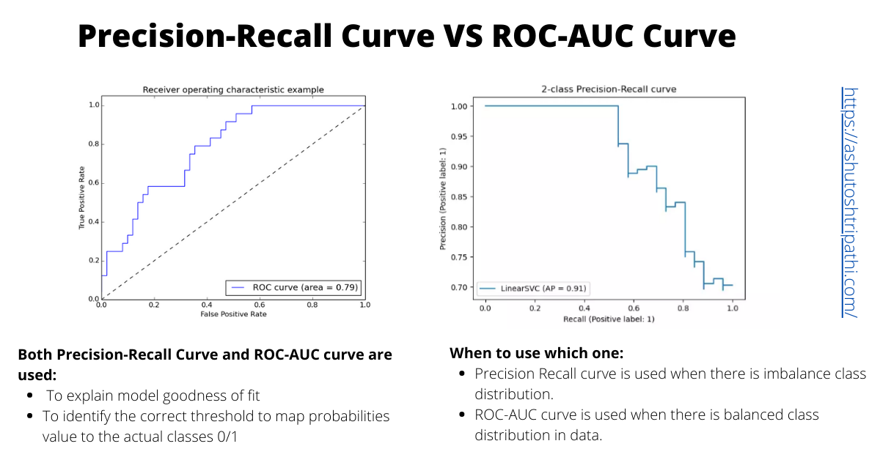
ROC AUC & Precision — Recall curves

Slide 28
Conclusion
Performance metrics quantify the quality of predictions made by machine learning models.
Machine learning performance metrics provide deeper insights into a model's strengths and weaknesses, which enables informed decisions about model selection, hyperparameter tuning, and monitoring model performance over time.
They provide actionable insights for model evaluation, comparison, and improvement.
One important thing to note is that we can adjust these metrics to cater to our specific use case.

Slide 29
Thanks

